Slide 1
NON SYLLABUS PROJECT
POORNIMA GROUP OF INSTITUTIONS

Slide 2
Submitted by:-
Registration No:-PGI20CA028
Name:- Prabhupad Vyas
Section:- G
College:- PGI
Topic:- E-Learning
Registration No:-PGI20CA027
Name:-Nipun Tiwari
Section:-G
College:-PGI
Topic:- E-Learning

Slide 3
Abstract:-
With the onset of novel corona virus pandemic in early 2020, the major hurdle faced by the educational institutions was to provide continuous and uninterrupted tutoring in the absence of physical availability of the students. Initially, the institutions felt tremendous pressure to provide education to the large amount of students due to the temporary closure of schools, colleges, universities and coaching classes etc. Thus, to overcome the difficulty of physical absence of the students in classrooms, an innovative trend of teaching through virtual classroom has begun to rise. With the influx of video conferencing platforms such as zoom, webEX , Microsoft teams etc., E- learning has become more convenient option to continue imparting knowledge. In the present scenario, E-learning is the most suitable, preferable and accessible and acceptable medium of learning. However, education through E-learning for the prolonged period has shown some failures of its own. The problems faced by the students as well as tutors in virtual classrooms are bound to increase if such ways of teaching continues. Problems related to student participation and interactions are a basic problem in E-learning. Thus, the E-learning can be temporary solution for teaching during the times of current pandemic but it cannot replace the traditional ways of teaching.

Slide 4
What is E-Learning ?
A learning system based on formalised teaching but with the help of electronic resources is known as E-learning. While teaching can be based in or out of the classrooms, the use of computers and the Internet forms the major component of E-learning.

Slide 5
E-Learning:- BANE or BOON ?
BANE
Saves time and money.
Better retention.
Personalized learning.
Environment-friendly.
BOON
Lacks social interaction.
Cheating is unavoidable.
Focuses more on theory.
Inaccessible to others.

Slide 6
Conclusion:-
In conclusion, it can be said that e-learning is a good alternative for the single biggest reason that it protects students and teacher from any viral infection of covid-19. It regularizes the studies without halt. But it can be said that the e-learning can not be treated at par with the traditional ways of learning in campus. There are several disadvantages of E-learning which may be kept on mind. It can be said that once this aftermath of corona will be over, the colleges, schools and universities will be back on normal terms and regular classes in campuses will replace online learning.

Slide 7
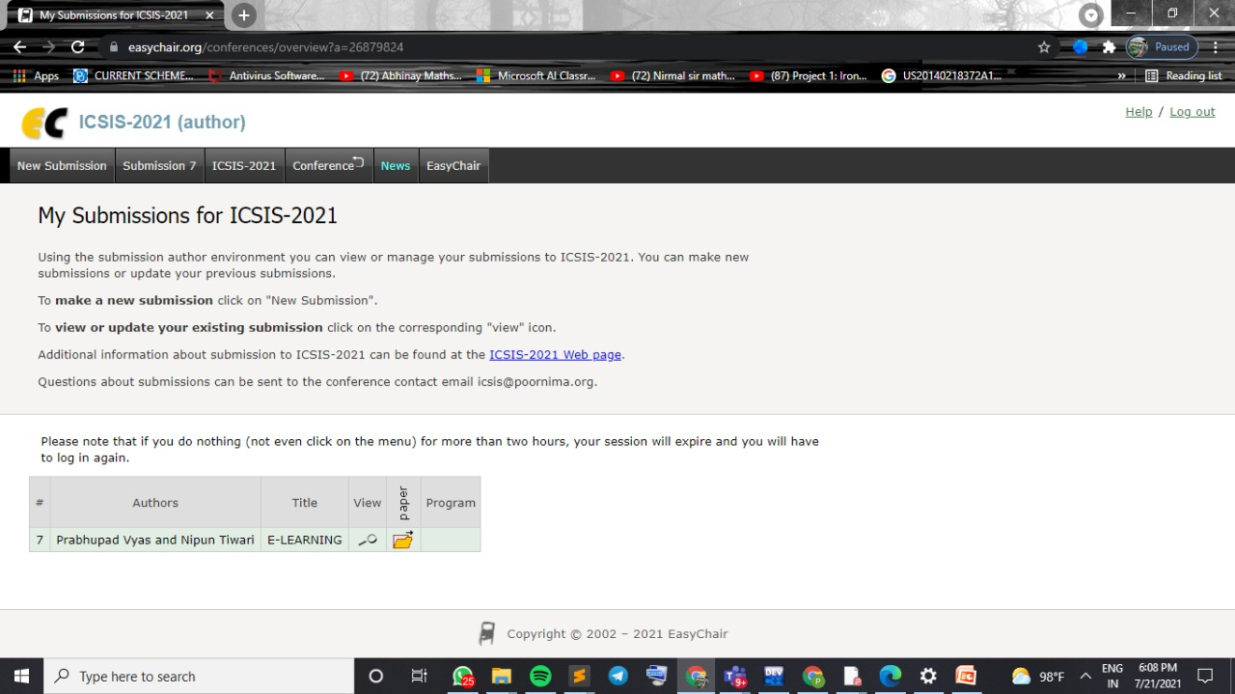

Slide 8
